Slide 1
React
Revision
Meki Khan
Notes:
.

Slide 2
MERN
MongoDB — document database
Express.js — Node.js web framework
React.js — a client-side JavaScript
Node.js — JavaScript web server
MERN is used to build full-stack applications where:
React.js handles the frontend (UI)
Express.js & Node.js handle the backend (API & server logic)
MongoDB stores and manages data

Slide 3
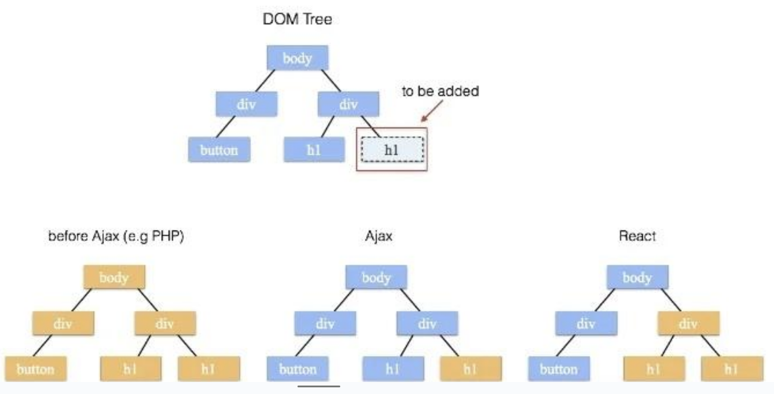
Virtual DOM
Why is it still FASTER?

Slide 4
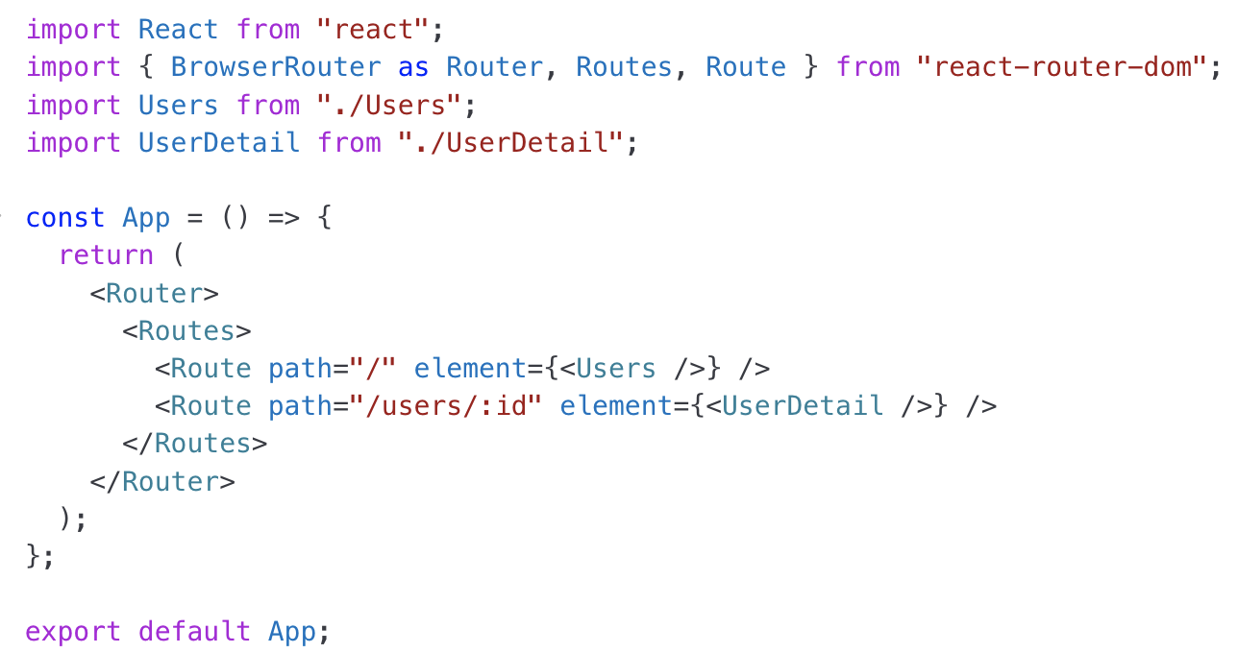
ROUTES
Why?

Slide 5
JSX
What is JSX JSX (JavaScript XML) is a syntax extension of JavaScript
Allows writing HTML-like code inside JavaScript
Most important Rule of JSX?
Must return a single parent element
Use camelCase for attributes (e.g., className instead of class)
Must close all tags (e.g., <br /> instead of <br>)
Embed JavaScript with {} (e.g., {2 + 2} → 4)

Slide 6
Event Handling
Events are camelCased → Instead of onclick, use onClick.
Use function references, not strings → Instead of onclick="myFunction()", use onClick={myFunction}.
event.preventDefault() is needed → In React, you must call event.preventDefault() manually for form submissions or link clicks.

Slide 7
Difference between Class and Function Components
Syntax
Class Component:
Needs render() method
Uses methods like componentDidMount, componentDidUpdate, componentWillUnmount
Function Components:
UseEffect
Uses Hooks (useState, useEffect, etc.)

Slide 8
Props
Props (short for "Properties") are used to pass data from a parent component to a child component in React. They make components reusable by allowing dynamic values.
Read-only: Cannot be modified inside the child component. Passed from Parent to Child: Data flows in one direction (top to bottom). Make Components Reusable: A single component can be used with different props.

Slide 9
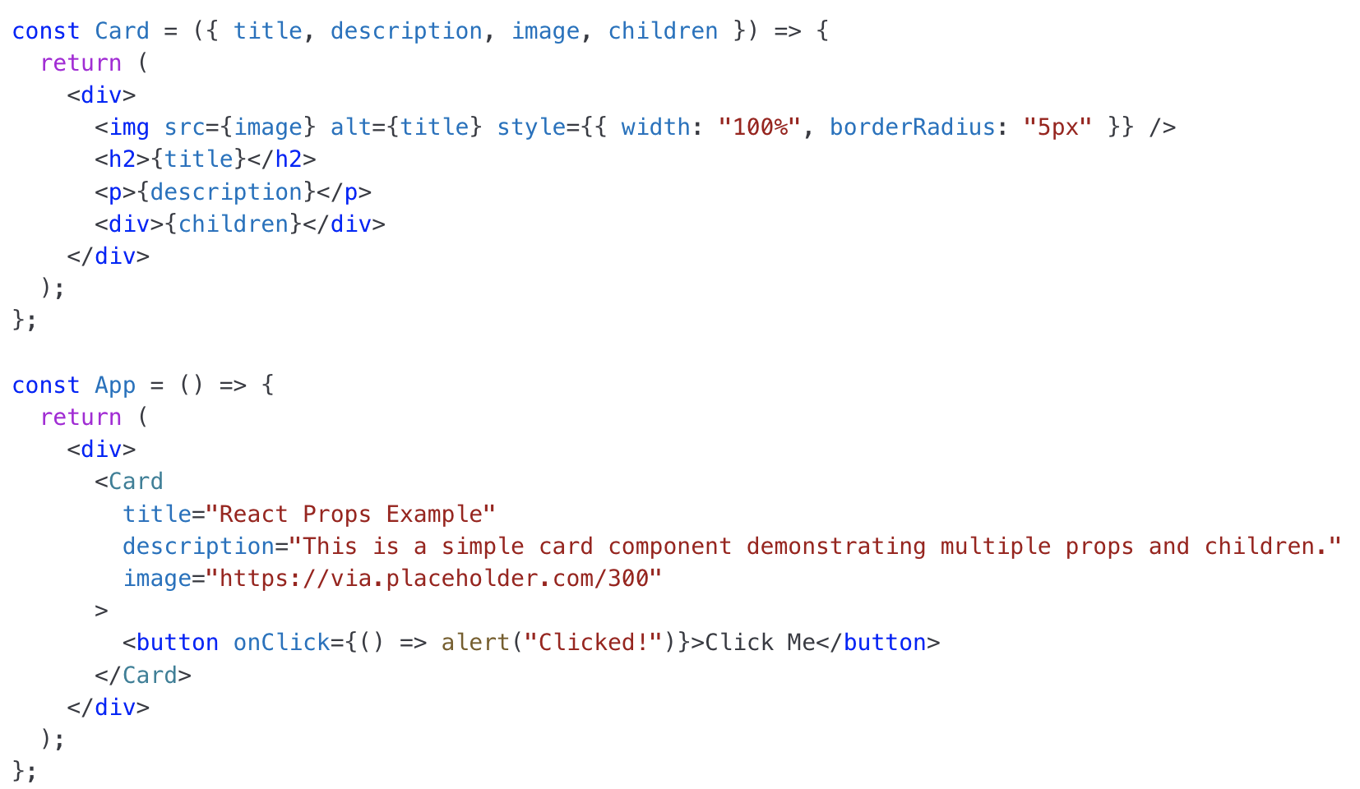
Props

Slide 10
useState
Purpose:
useState is a React hook used for managing state in functional components.
Syntax:
It returns an array with two values:
The current state value.
A function to update the state.
const [count, setCount] = useState(0);
Reactivity:
When the state updates using setState, React re-renders the component to reflect the new state.

Slide 11
useState
Initial State:
The initial state can be a primitive value, an object
const [name, setName] = useState("John");
const [user, setUser] = useState({ name: "Alice", age: 25 });
Use Functional Updates for Correct State Updates:
If the new state depends on the previous state, use a callback function.
setCount(prevCount => prevCount + 1);
State Is Local to Component:
useState only works inside functional components.
Each component instance maintains its own separate state.

Slide 12
useRef
Purpose:
useRef is a React hook used for accessing and persisting values without causing re-renders.
It is commonly used for:
Accessing DOM elements.
Storing mutable values that persist across renders.
Syntax:
useRef returns an object with a current property:
Accessing DOM Elements:
useRef is often used to get a reference to a DOM element without using document.querySelector().
Persistent Values Without Re-Renders:
Unlike useState, updating useRef.current does not trigger a re-render.

Slide 13
useEffect
Purpose:
Can be used to
Fetching data from an API, On mount, On cleanup, On change of state
Runs on Every Render (No Dependencies):
useEffect(() => {
console.log("Component rendered!"); });
Runs Once on Mount ([] as Dependency):
useEffect(() => {
console.log("Component mounted!");
}, []);
Runs on Specific Changes ([dependency]):
useEffect(() => {
console.log("Count changed:", count);
}, [count]);
Cleaning Up Effects:
useEffect(() => {
const interval = setInterval(() => {
console.log("Interval running...");
}, 1000);
return () => {
clearInterval(interval);
};
}, []);

Slide 14
&& Conditional rendering
{props.hasMessages && <p>You have new messages!</p>}

Slide 15
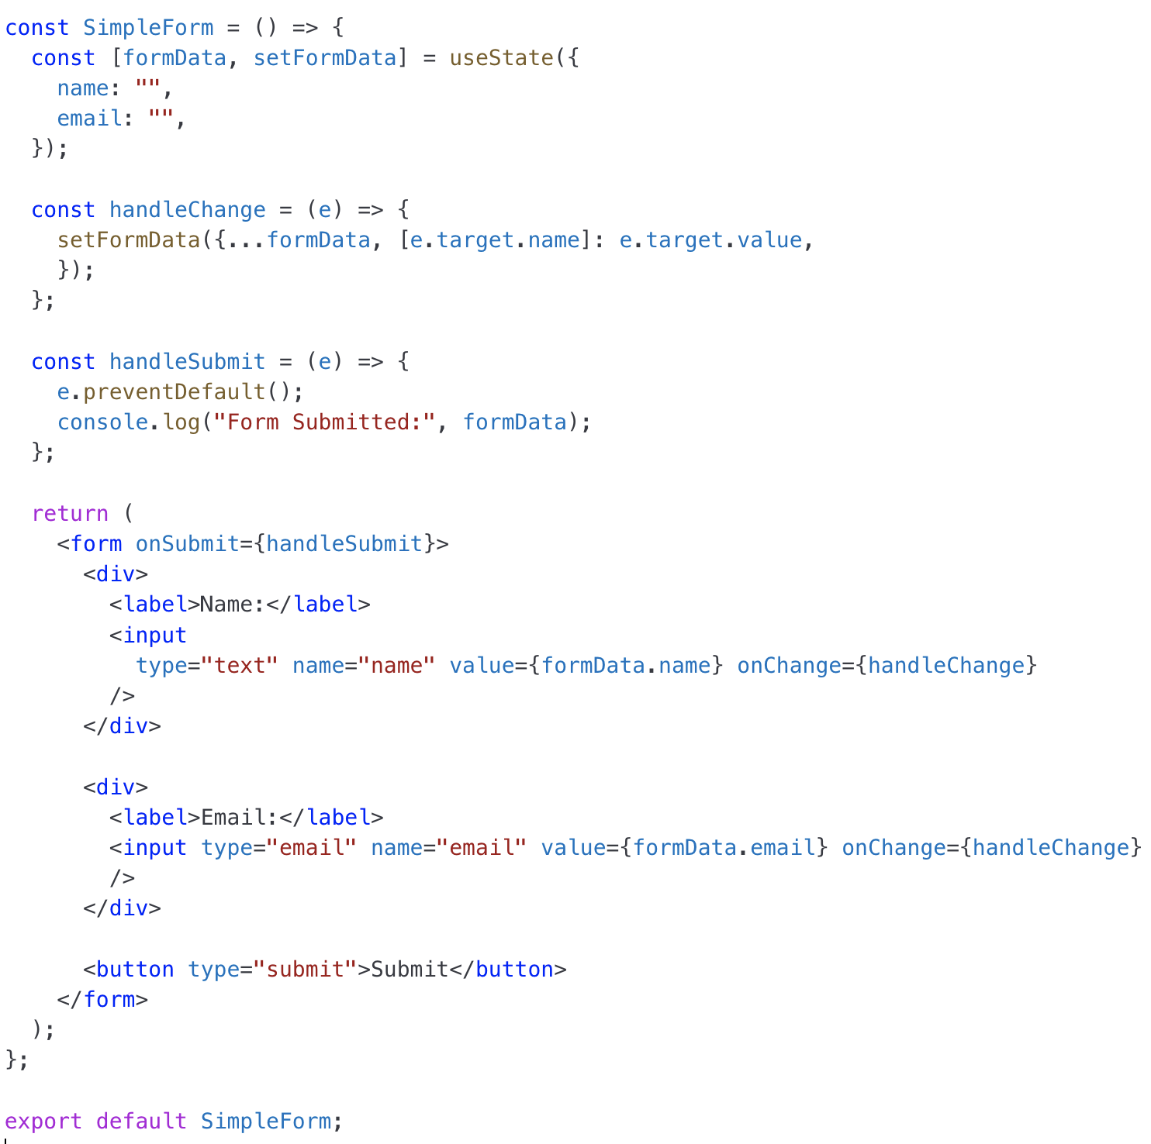
Forms

Slide 16
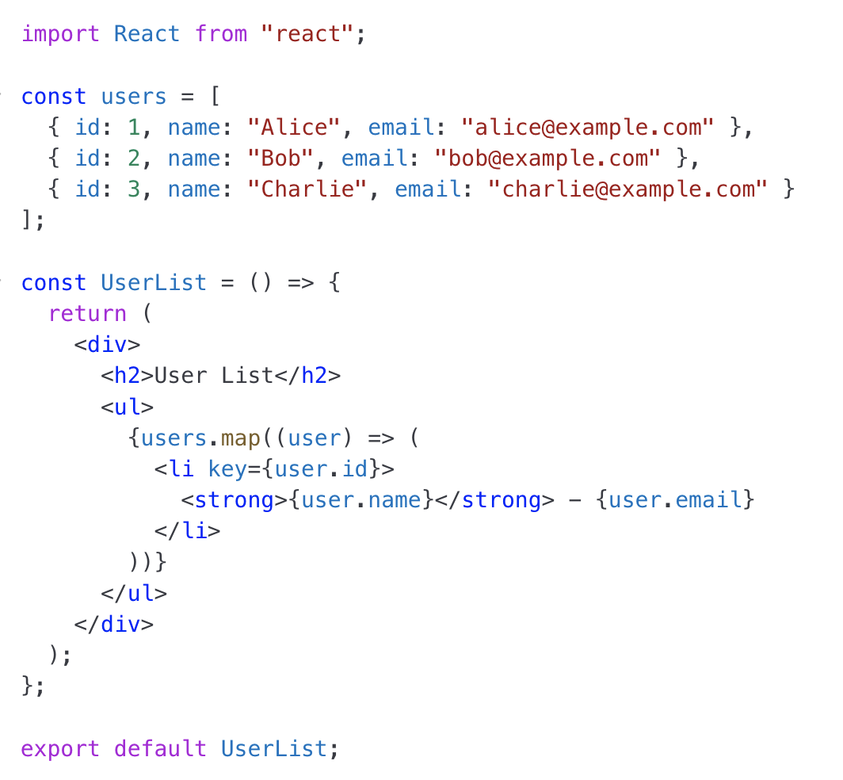
Display objects

Slide 17
Redux Toolkit
Store (Central place for state)
The global state of your app.
Components get data from and send updates to the store.
Actions (Slice)
Actions are messages that tell Redux what changes should happen
Reducers (Slice)
Pure Functions that modify the store when actions are dispatched.
Dispatch (Send actions to update the state)
Used in components to trigger actions.
Selectors (Read data from the store)
Used in components to get data from Redux (useSelector()).

Slide 18
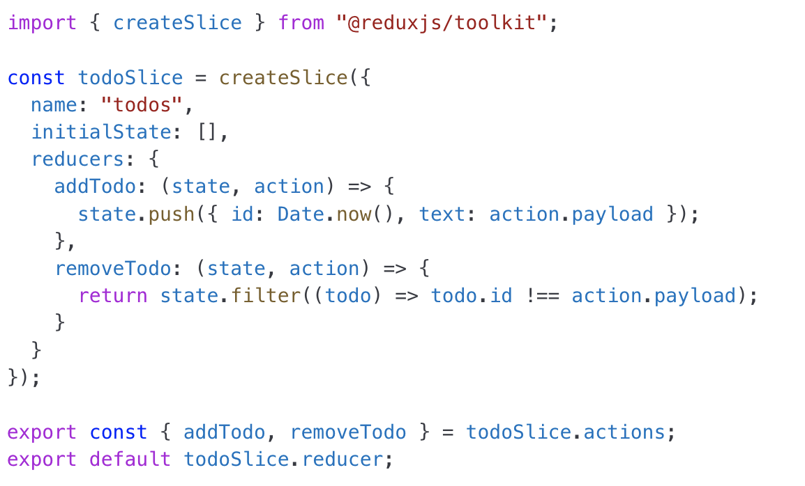
Redux Slice (todoSlice.js)

Slide 19
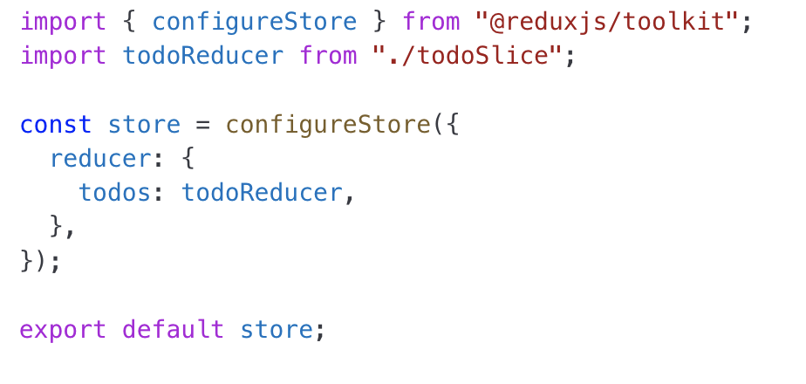
store.js

Slide 20
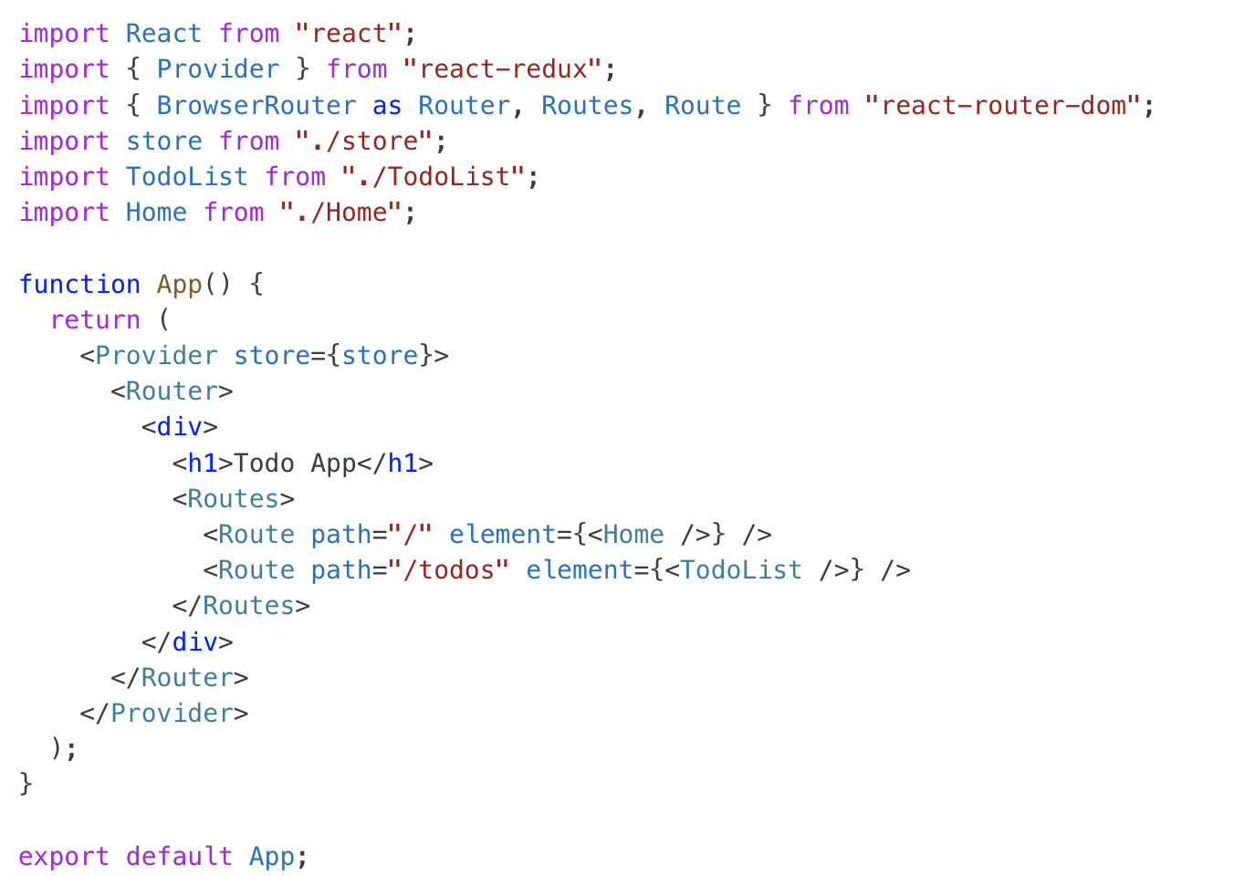
app.js

Slide 21
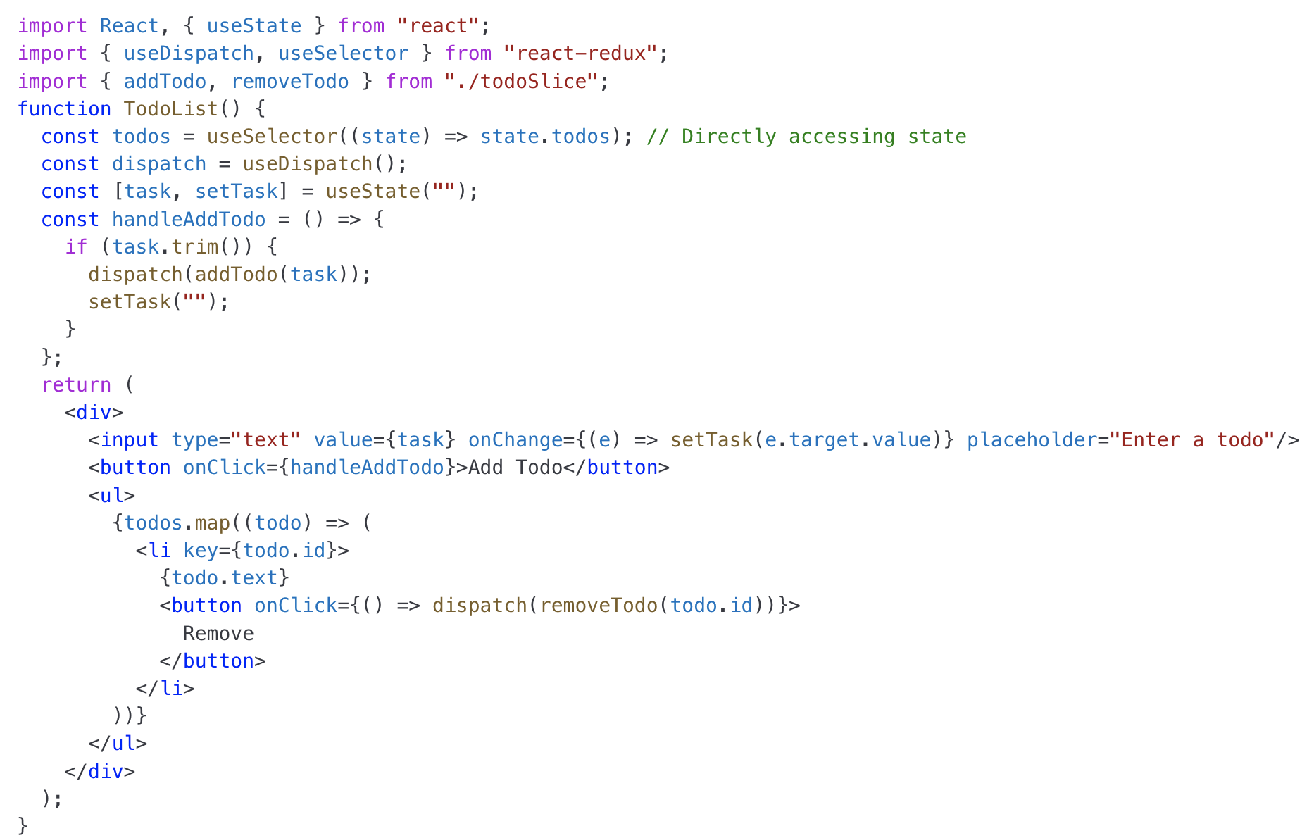
TodoList.js

Slide 22
Good Luck !!! :)
Example TodoList Project Attached, Please study!!

